Slide 1
HELLO
DATA REPRESNTATION

Slide 2
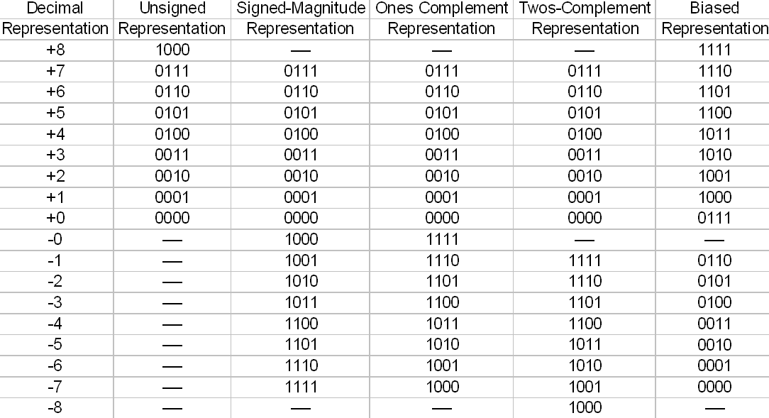
BINARY SYSTEM
A binary number system, is a base-2 number system used to represent numerical values ​​using two symbols, usually 0 and 1. Any two symbols or states such as 0 and 1, true/false, or on/off can also be used.

Slide 3
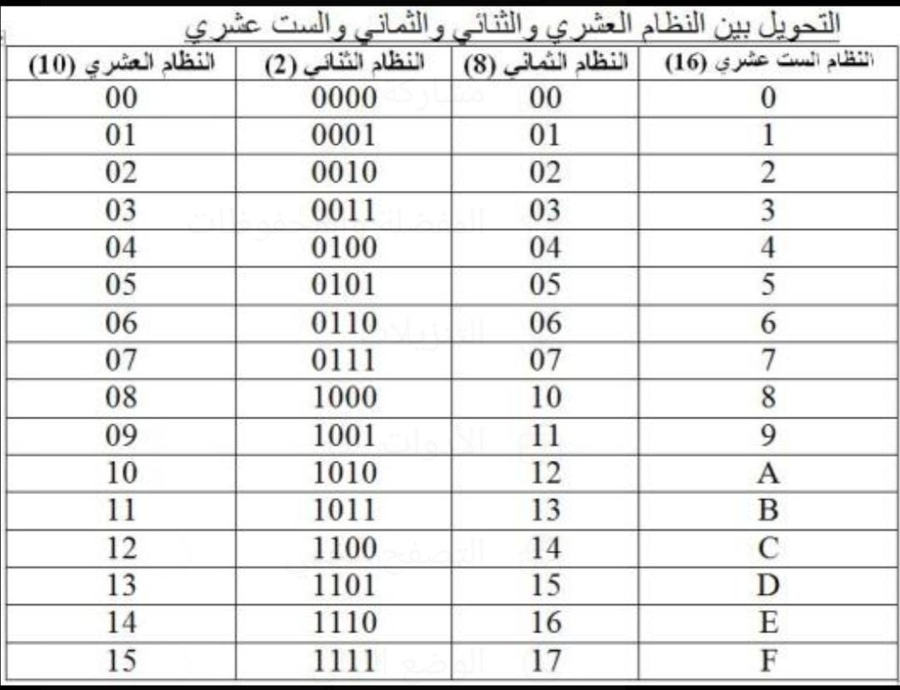
HEXADECIMAL SYSTEM
In mathematics and computing, the hexadecimal number system is a numerical notation with integer orders of 16. The symbols {0, 1, 2, 3, 4, 5, 6, 7, 8, 9, F, E, D, C, B, A} to represent the values ​​of the numbers within the first digit in ascending order according to the sequence of their occurrence, then it is reused again to write the rest of the digits according to the value of the digit.

Slide 4
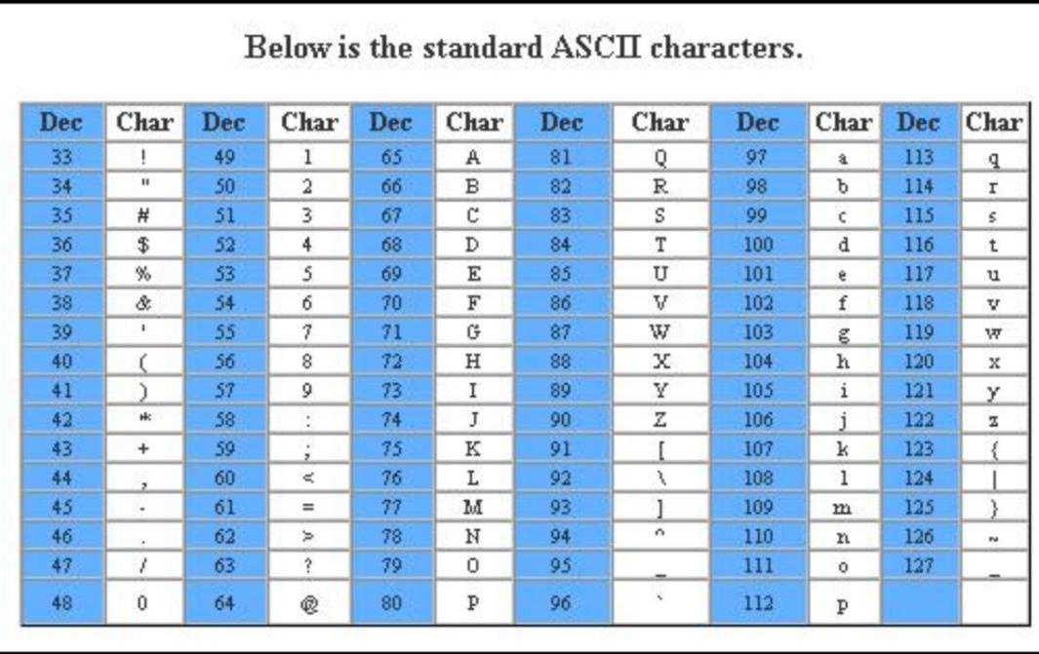
ASCII CODE
A set of symbols and notation systems based on the Latin alphabet as it is used in modern English and other Western European languages. One of the most common uses of ASCII scripts is in computer systems, communication devices, and control systems that deal with text.

Slide 5

THANKS FOR READING

